Slide 1
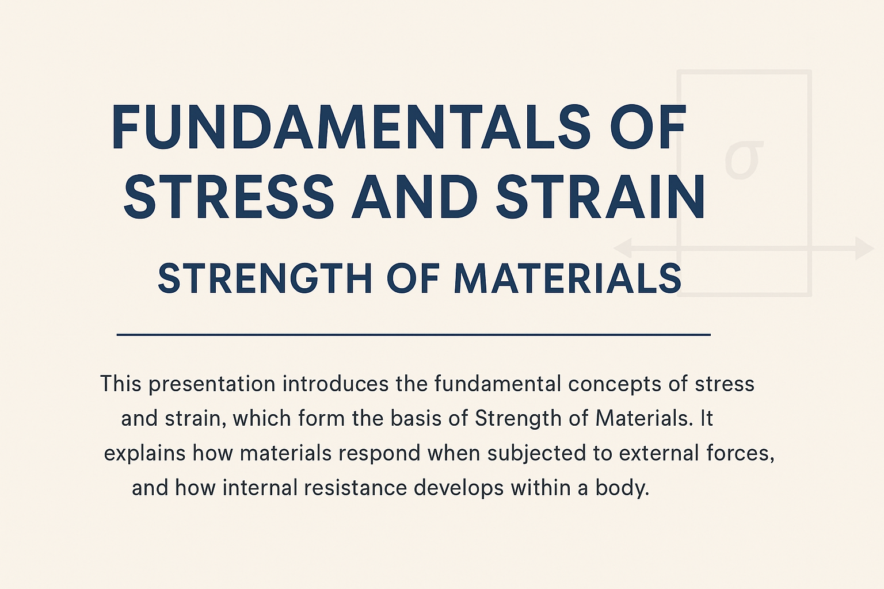

Slide 2
1.1 Introduction
In engineering practice, the machine parts are subjected to various forces which may be due to either one or more of the following:
  1. Energy transmitted,
  2. Weight of machine,
  3. Frictional resistances,
  4. Inertia of reciprocating parts,
  5. Change of temperature, and
  6. Lack of balance of moving parts.
The different forces acting on a machine part produces various types of stresses, which will be discussed in this
topic.

Slide 3
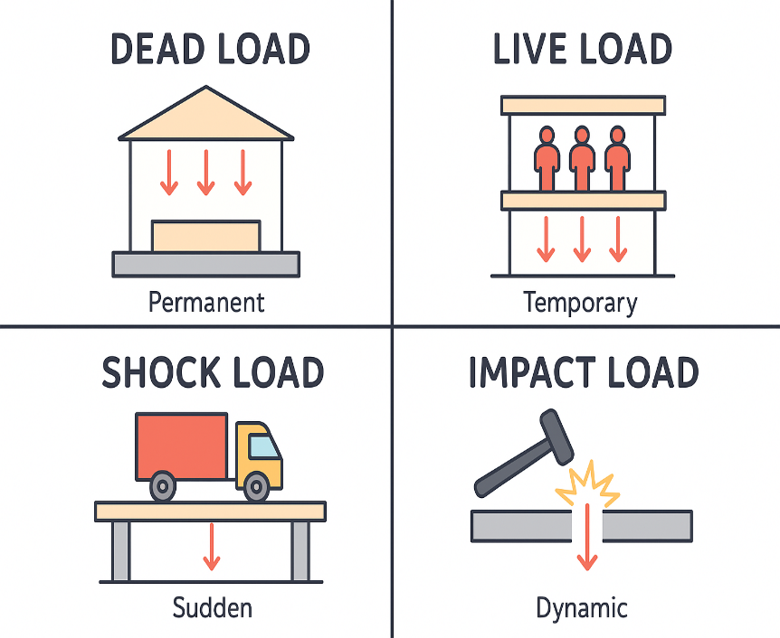
1.2 Load
It is defined as any external force acting upon a machine part. The following four types of the load are important from the subject point of view:
1. Dead or steady load- does not change in magnitude or direction.
2. Live or variable load. A - changes continually.
3. Suddenly applied or shock loads -suddenly applied or removed.
4. Impact load- applied with some initial velocity.
Note: A machine part resists a dead load more easily than a live load and a live load more easily than a shock load.

Slide 4
1.3 Stress
When some external system of forces or loads act on a body, the internal forces (equal and opposite) are set up at various sections of the body, which resist the external forces. This internal force per unit area at any section of the body is known as unit stress or simply a stress. It is denoted by a Greek letter sigma . Mathematically,

Slide 5
1.4 Strain
When a system of forces or loads act on a body, it undergoes some deformation. This deformation per unit length is known as unit strain or simply a strain. It is denoted by a Greek letter epsilon
Mathematically,
1.5 Tensile Stress and Strain
Fig. 1.1. Tensile stress and strain.

Slide 6
When a body is subjected to two equal and opposite axial pulls P (also called tensile load) as shown in Fig. 1.1 (a), then the stress induced at any section of the body is known as tensile stress as shown in Fig. 1.1 (b). A little consideration will show that due to the tensile load, there will be a decrease in cross-sectional area and an increase in length of the body. The ratio of the increase in length to the original length is known as tensile strain.

Slide 7
1.6 Compressive Stress and Strain
When a body is subjected to two equal and opposite axial pushes P (also called compressive load) as shown in Fig. 1.2 (a), then the stress induced at any section of the body is known as compressive stress as shown in Fig. 1.2 (b). A little consideration will show that due to the compressive load, there will be an increase in cross-sectional area and a decrease in length of the body. The ratio of the decrease in length to the original length is known as compressive strain.
Fig. 1.2 : Compressive stress and strain

Slide 8
1.7 Young's Modulus or Modulus of Elasticity
Hooke's law* states that when a material is loaded within elastic limit, the stress is directly proportional to strain, i.e.
There fore

Slide 9
Table 1.1. Values of E for the commonly used engineering materials.

Slide 10
Example 1.1. A hydraulic press exerts a total load of 3.5 MN. This load is carried by two steel rods, supporting the upper head of the press. If the safe stress is 85 MPa and E = 210 kN/mm² find : 1. diameter of the rods, and 2. extension in each rod in a length of 2.5 m.

Slide 12
1.8 Shear Stress and Strain
When a body is subjected to two equal and opposite forces acting tangentially across the resisting section, as a result of which the body tends to shear off the section, then the stress induced is called shear stress.
Fig. 1.3. Single shearing of a riveted joint..

Slide 13
Consider a body consisting of two plates connected by a rivet as shown in Fig. 1.3 (a). In this case, the tangential force P tends to shear off the rivet at one cross-section as shown in Fig. 1.3 (b). It
may be noted that when the tangential force is resisted by one cross-section of the rivet (or when shearing takes place at one cross-section of the rivet), then the rivets are said to be in single shear. In such a case, the area resisting the shear off the rivet,

Slide 14
Now let us consider two plates connected by the two cover plates as shown in Fig. 1.4 (a). In this case, the tangential force P tends to shear off the rivet at two cross-sections as shown in Fig. 1.4 (b). It may be noted that when the tangential force is resisted by two cross-sections of the rivet (or when the shearing takes place at two cross-sections of the rivet), then the rivets are said to be in double shear. In such a case, the area resisting the shear off the rivet,

Slide 15
Fig. 1.4 Double shearing of a riveted joint.

Slide 17
1.9 Shear Modulus or Modulus of Rigidity
Table 4.2. Values of C for the commonly used materials.

Slide 18
Example 1.2. A pull of 80 kN is transmitted from a bar X to the bar Y through a pin as shown in Fig. 1.5. If the maximum permissible tensile stress in the bars is 100 N/mm² and the permissible shear stress in the pin is 80 N/mm², find the diameter of bars and of the pin.
    Fig. 1.5

Slide 21
1.10 Stress-strain Diagram
In designing various parts of a machine, it is necessary to know how the material will function in service. For this, certain characteristics or properties of the material should be known. The mechanical properties mostly used in mechanical engineering practice are commonly determined from a standard tensile test. This test consists of gradually loading a standard specimen of a material and noting the corresponding values of load and elongation until the specimen fractures. The load is applied and measured by a testing machine. The stress is determined by dividing the load values by the original cross-sectional area of the specimen. The elongation is measured by determining the amounts that two reference points on the specimen are moved apart by the action of the machine. The original distance between the two reference points is known as gauge length. The strain is determined by dividing the elongation values by the gauge length.

Slide 22
The values of the stress and corresponding strain are used to draw the stress-strain diagram of the material tested. A stress-strain diagram for a mild steel under tensile test is shown in Fig. 1.6 (a). The various properties of the material are discussed below :
Fig. 1.6 . Stress-strain diagram for a mild steel.

Slide 23
1. Proportional limit. We see from the diagram that from point O to A is a straight line, which represents that the stress is proportional to strain. Beyond point A, the curve slightly deviates from the straight line. It is thus obvious, that Hooke's law holds good up to point A and it is known as proportional limit. It is defined as that stress at which the stress-strain curve begins to deviate from the straight line.
2. Elastic limit. It may be noted that even if the load is increased beyond point A upto the point B, the material will regain its shape and size when the load is removed. This means that the material has elastic properties up to the point B. This point is known as elastic limit. It is defined as the stress developed in the material without any permanent set.
  Note: Since the above two limits are very close to each other, therefore, for all practical purposes these are taken to be equal.

Slide 24
3. Yield point. If the material is stressed beyond point B, the plastic stage will reach i.e. on the removal of the load, the material will not be able to recover its original size and shape. A little consideration will show that beyond point B, the strain increases at a faster rate with any increase in the stress until the point C is reached. At this point, the material yields before the load and there is an appreciable strain without any increase in stress. In case of mild steel, it will be seen that a small load drops to D, immediately after yielding commences. Hence there are two yield points C and D. The points C and D are called the upper and lower yield points respectively. The stress corresponding to yield point is known as yield point stress.
4. Ultimate stress. At D, the specimen regains some strength and higher values of stresses are required for higher strains, than those between A and D. The stress (or load) goes on increasing till the point E is reached. The gradual increase in the strain (or length) of the specimen is followed with the uniform reduction of its cross-sectional area. The work done, during stretching the specimen, is transformed largely into heat and the specimen becomes hot. At E, the stress, which attains its maximum value is known as ultimate stress. It is defined as the largest stress obtained by dividing the largest value of the load reached in a test to the original cross-sectional area of the test piece.

Slide 25
5. Breaking stress. After the specimen has reached the ultimate stress, a neck is formed, which decreases the cross-sectional area of the specimen, as shown in Fig. 4.12 (b). A little consideration will show that the stress (or load) necessary to break away the specimen, is less than the maximum stress. The stress is, therefore, reduced until the specimen breaks away at point F. The stress corresponding to point F is known as breaking stress.
  Note : The breaking stress (i.e. stress at F which is less than at E) appears to be somewhat misleading. As the formation of a neck takes place at E which reduces the cross-sectional area, it causes the specimen suddenly to fail at F. If for each value of the strain between E and F, the tensile load is divided by the reduced crosssectional area at the narrowest part of the neck, then the true stress-strain curve will follow the dotted line EG. However, it is an established practice, to calculate strains on the basis of original cross-sectional area of the specimen.

Slide 27
Note : The percentage elongation gives a measure of ductility of the metal under test. The amount of local extensions depends upon the material and also on the transverse dimensions of the test piece. Since the specimens are to be made from bars, strips, sheets, wires, forgings, castings, etc., therefore it is not possible to make all specimens of one standard size. Since the dimensions of the specimen influence the result, therefore some standard means of comparison of results are necessary.

Slide 29
Example 1.3. A mild steel rod of 12 mm diameter was tested for tensile strength with the gauge length of 60 mm. Following observations were recorded : Final length = 80 mm; Final diameter = 7 mm; Yield load = 3.4 kN and Ultimate load = 6.1 kN.
Calculate : 1. yield stress, 2. ultimate tensile stress, 3. percentage reduction in area, and 4. percentage elongation.

Slide 31
1.11 Working Stress
When designing machine parts, it is desirable to keep the stress lower than the maximum or ultimate stress at which failure of the material takes place. This stress is known as the working stress or design stress. It is also known as safe or allowable stress.
  Note : By failure it is not meant actual breaking of the material. Some machine parts are said to fail when they have plastic deformation set in them, and they no more perform their function satisfactory.

Slide 32
1.12 Factor of Safety
It is defined, in general, as the ratio of the maximum stress to the working stress. Mathematically,

Slide 33
1.13 Selection of Factor of Safety
The selection of a proper factor of safety to be used in designing any machine component depends upon a number of considerations, such as the material, mode of manufacture, type of stress, general service conditions and shape of the parts. Before selecting a proper factor of safety, a design engineer should consider the following points :
  1. The reliability of the properties of the material and change of these properties during service ;
  2. The reliability of test results and accuracy of application of these results to actual machine parts ;
  3. The reliability of applied load ;
  4. The certainty as to exact mode of failure ;
  5. The extent of simplifying assumptions ;
  6. The extent of localised stresses ;
  7. The extent of initial stresses set up during manufacture ;
  8. The extent of loss of life if failure occurs ; and
  9. The extent of loss of property if failure occurs.

Slide 34
Each of the above factors must be carefully considered and evaluated. The high factor of safety results in unnecessary risk of failure. The values of factor of safety based on ultimate strength for different materials and type of load are given in the following table:
Table 1.3. Values of factor of safety.

Slide 35
1.14 Stresses in Composite Bars
A composite bar may be defined as a bar made up of two or more different materials, joined together, in such a manner that the system can extends or contracts as one unit, equally, when subjected to tension or compression respectively.
In case of composite bars, the following points should be kept in view:
  1. The extension or contraction of the bar being equal, the strain i.e. deformation per unit length is also equal.
  2. The total external load on the bar is equal to the sum of the loads carried by different materials.
Consider a composite bar made up of two different materials as shown in Fig. 1.7 below.

Slide 36
Fig. 1.7 . Stresses in composite bars.

Slide 39
Example 1.4. A bar 3 m long is made of two bars, one of copper having E = 105 GN/m² and the other of steel having E = 210 GN/m². Each bar is 25 mm broad and 12.5 mm thick. This compound bar is stretched by a load of 50 kN. Find the increase in length of the compound bar and the stress produced in the steel and copper. The length of copper as well as of steel bar is 3 m each.

Slide 41
1.15 Stresses due to Change in Temperature—Thermal Stresses
Whenever there is some increase or decrease in the temperature of a body, it causes the body to expand or contract. A little consideration will show that if the body is allowed to expand or contract freely, with the rise or fall of the temperature, no stresses are induced in the body. But, if the deformation of the body is prevented, some stresses are induced in the body. Such stresses are known as thermal stresses.

Slide 43
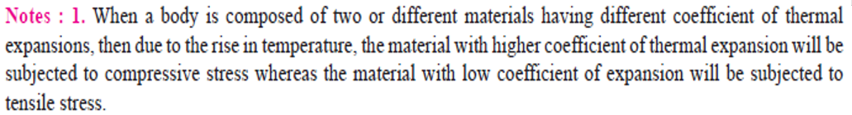

Slide 44
1.16. Linear and Lateral Strain
Consider a circular bar of diameter d and length l, subjected to a tensile force P as shown in Fig. 1.8 (a).
Fig. 1.8. Linear and lateral strain.
A little consideration will show that due to tensile force, the length of the bar increases by an amount δl and the diameter decreases by an amount δd, as shown in Fig. 1.8 (b). Similarly, if the bar is subjected to a compressive force, the length of bar will decrease which will be followed by increase in diameter.

Slide 45
Point to Note
It is thus obvious, that every direct stress is accompanied by a strain in its own direction which is known as linear strain and an opposite kind of strain in every direction, at right angles to it, is known as lateral strain.

Slide 46
1.17 Poisson's Ratio
It has been found experimentally that when a body is stressed within elastic limit, the lateral strain bears a constant ratio to the linear strain, Mathematically,
Table 1.4. Values of Poisson’s ratio for commonly used materials.

Slide 47
1.18 Volumetric Strain

Slide 48
1.19 Bulk Modulus
When a body is subjected to three mutually perpendicular stresses, of equal intensity, then the ratio of the direct stress to the corresponding volumetric strain is known as Bulk modulus. It is usually denoted by K. Mathematically, bulk modulus,

Slide 49
1.20 Relation Between Bulk Modulus and Young’s Modulus
The bulk modulus (K) and Young's modulus (E) are related by the following relation,
1.21 Relation Between Young’s Modulus and Modulus of Rigidity
The Young's modulus (E) and modulus of rigidity (G) are related by the following relation,

Slide 50
Example 1.5. A steel bar 2.4 m long and 30 mm square is elongated by a load of 500 kN. If poisson's ratio is 0.25, find the increase in volume. Take E = 0.2 × 10⁶N/mm².

Slide 51
1.22 Impact Stress
Sometimes, machine members are subjected to the load with impact. The stress produced in the member due to the falling load is known as impact stress.
Consider a bar carrying a load W at a height h and falling on the collar provided at the lower end, as shown in Fig. 1.9.
Fig. 1.9. Impact stress.

Slide 53
Example 1.6. An unknown weight falls through 10 mm on a collar rigidly attached to the lower end of a vertical bar 3 m long and 600 mm² in section. If the maximum instantaneous extension is known to be 2 mm, what is the corresponding stress and the value of unknown weight W? Take E = 200 kN/mm².

Slide 55
1.23 Resilience
When a body is loaded within elastic limit, it changes its dimensions and on the removal of the load, it regains its original dimensions. So long as it remains loaded, it has stored energy in itself. On removing the load, the energy stored is given off as in the case of a spring. This energy, which is absorbed in a body when strained within elastic limit, is known as strain energy. The strain energy is always capable of doing some work.
The strain energy stored in a body due to external loading, within elastic limit, is known as resilience and the maximum energy which can be stored in a body up to the elastic limit is called proof resilience. The proof resilience per unit volume of a material is known as modulus of resilience. It is an important property of a material and gives capacity of the material to bear impact or shocks. Mathematically, strain energy stored in a body due to tensile or compressive load or resilience

Slide 57
Example 1.7. A wrought iron bar 50 mm in diameter and 2.5 m long transmits a shock energy of 100 N-m. Find the maximum instantaneous stress and the elongation. Take E = 200 GN/m².

Slide 58
THANK YOU !

